Slide 1
Instruction Set Architectures
Yuemin Ding
Tecnun, University of Navarra
Fall, 2021

Slide 2
Outline
Basics of instruction set
Addressing mode in instruction set
Instruction formats
OS support
^{<number>}

Slide 3
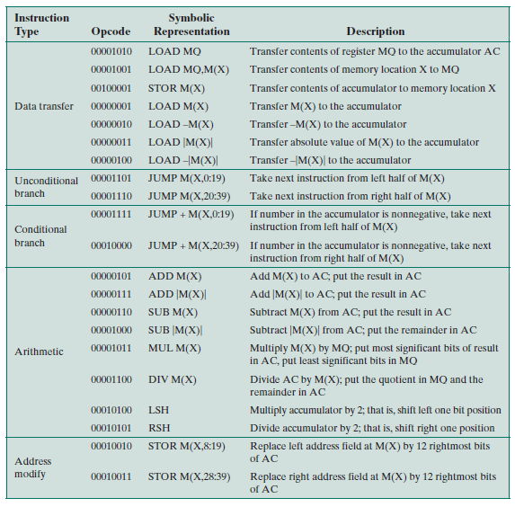
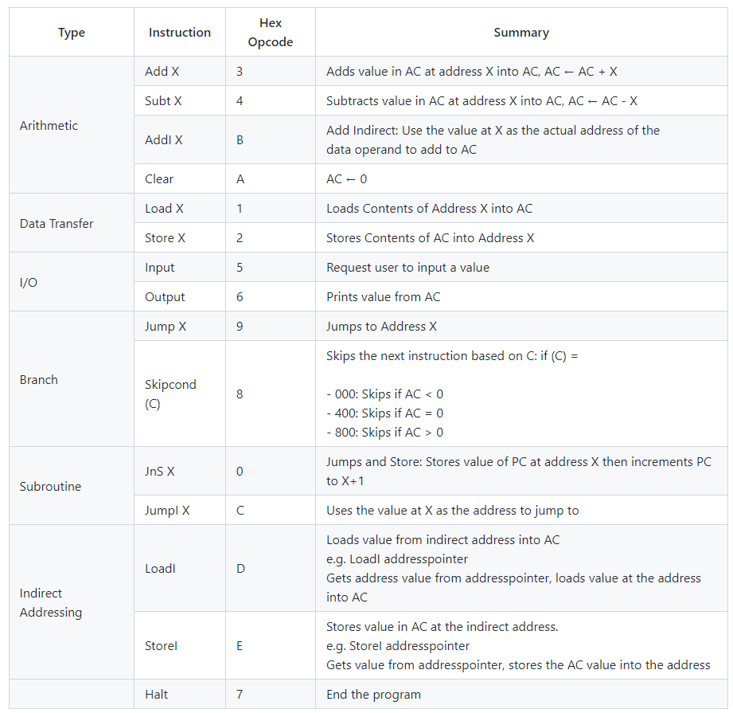
Basic Instruction Set
Each instruction is represented by a sequence of bits
IAS instruction set
Marie instruction set

Slide 4
Instruction Types
Instruction types include:
Data processing
→ Arithmetic and logic instructions, e.g. ADD, SHIFT
Data transfer
→ Movement of data into or out of register and or memory locations, e.g. LOAD
→ I/O instructions, e.g. Input, Output
Control
→ Test and branch instructions, e.g. CMP, JUMP
^{<number>}

Slide 5
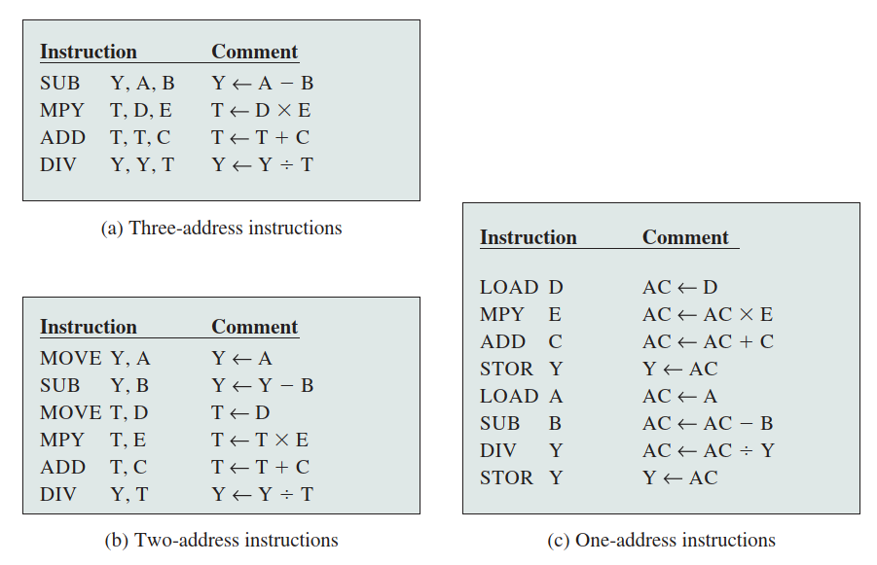
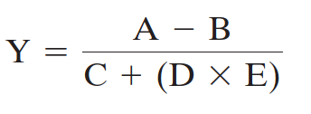
Number of Addresses
One-address instructions
Two-address instructions
Three-address instructions
^{<number>}

Slide 6
Question
Which instruction set, (a,b,c) requires support from the most complex processor?
Which one has the shortest total execution time?
^{<number>}

Slide 7
Outline
Basics of instruction set
Addressing mode in instruction set
Instruction formats
OS support
^{<number>}

Slide 8
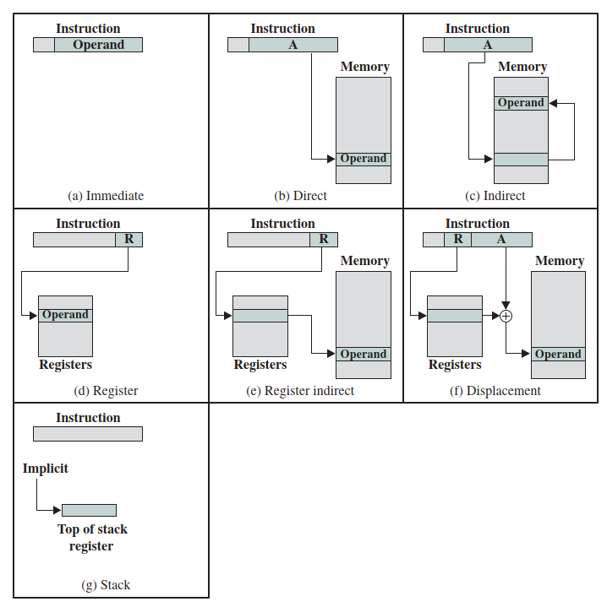
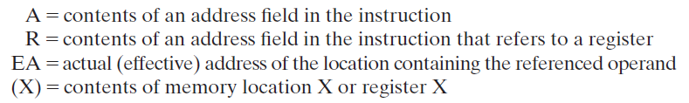
Addressing Modes
Addressing modes in instruction formats:
Immediate
Direct
Indirect
Register
Register indirect
Displacement
Stack
^{<number>}

Slide 9
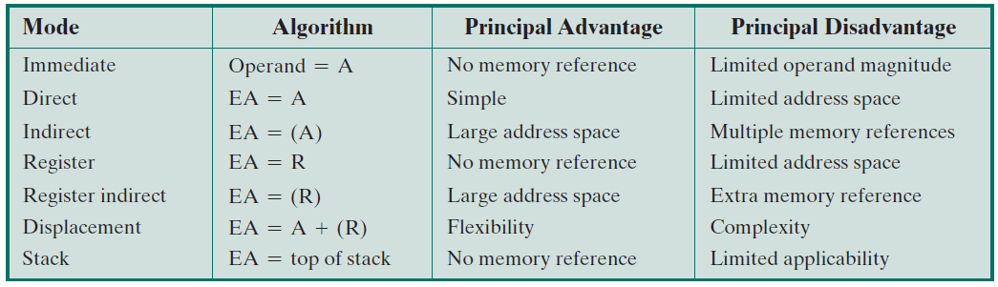
Addressing Modes
Addressing modes in instruction formats:
^{<number>}

Slide 10
Outline
Basics of instruction set
Addressing mode in instruction set
Instruction formats
OS support
^{<number>}

Slide 11
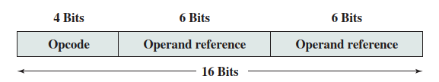
Instruction Formats
An instruction format defines the layout of the bits of an instruction.
An instruction format must include an opcode and zero/more operands.
The format must, implicitly or explicitly, indicate the addressing mode for each operand.
For most instruction sets, more than one instruction format is used
E.g. PDP-8, PDP-10, PDP-11, x86, ARM
An example of instruction format
^{<number>}

Slide 12
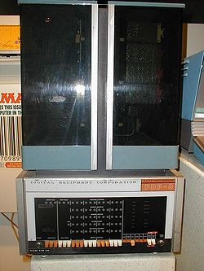
PDP-8 Instruction Format
One of the simplest instruction designs for a general-purpose computer
It uses 12-bit instructions and operates on 12-bit words.
PDP-8 computer in 1965
^{<number>}

Slide 13
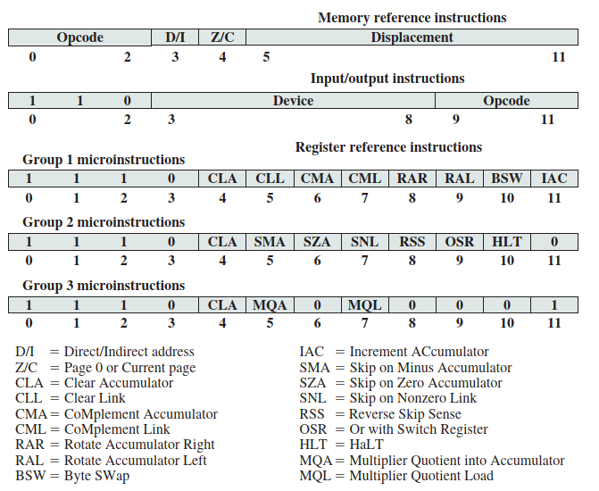
PDP-8 Instruction Format
PDP-8 supports 35 instructions in total
Opcode:
0-5 → Memory reference instruction
6 → I/O instruction
7 → Register reference instructions
^{<number>}

Slide 14
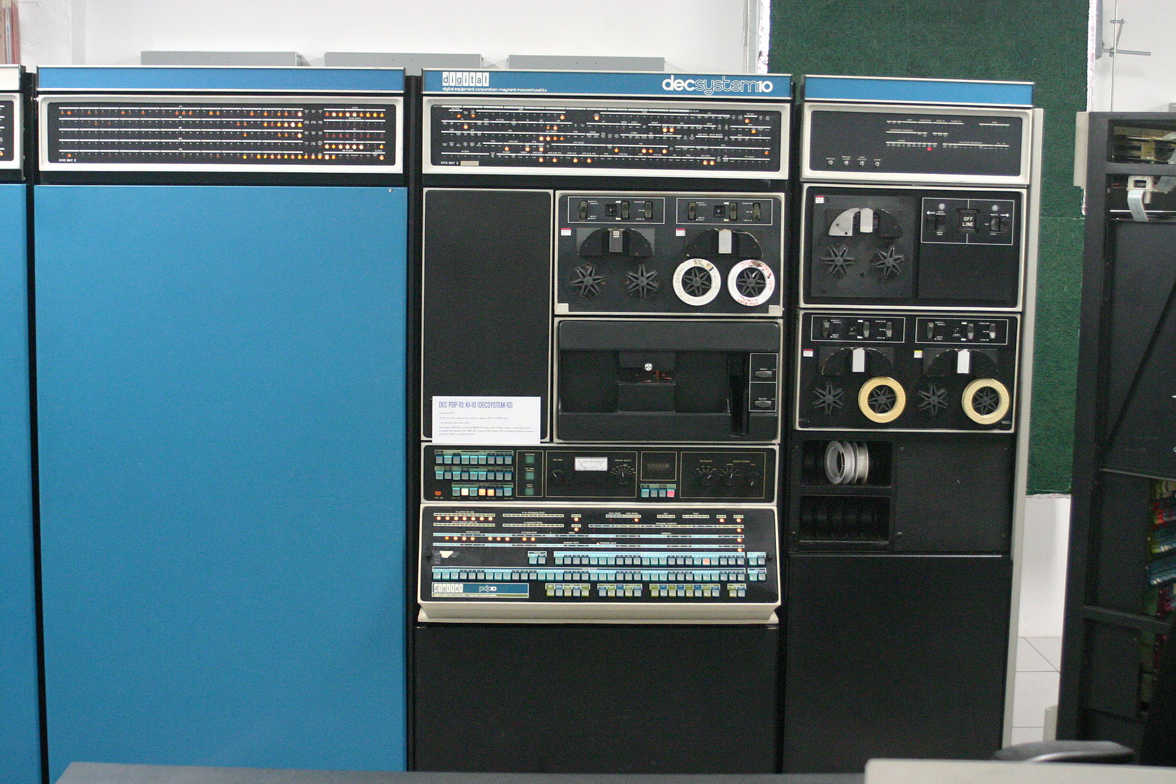
PDP-10 Instruction Format
PDP-10 was designed to be a large-scale time-shared system
It has a 36-bit word length and a 36-bit instruction length.
PDP-10 computer in 1983
^{<number>}
Notes:
http://www.hakmem.org/pdp-10.html

Slide 15

PDP-10 Instruction Format
The opcode occupies 9 bits, allowing up to 512 operations.
In fact, 365 instructions are defined.
16 (2⁴) registers are supported
Direct memory address up to 2¹⁸ words
PDP-10 is powerful, yet the use of 36-bit instruction is luxury
29
24
24
218
^{<number>}
Notes:
http://www.hakmem.org/pdp-10.html

Slide 16
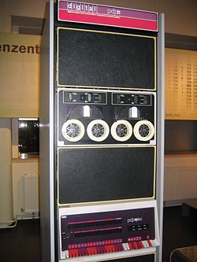
PDP-11 Instruction Format
PDP-8 and PDP-10 has fixed instruction length
PDP-11 adopts variable instruction length to be more flexible
PDP-11 computer in 1970
^{<number>}

Slide 17
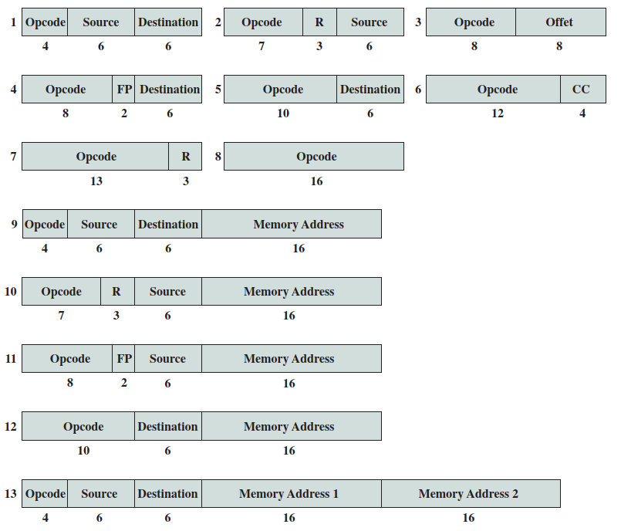
PDP-11 Instruction Format
13 different instruction formats are used.
PDP-11 instructions are usually 16-bit, suitable for 16-bit minicomputer.
32-bit and 48-bit instructions are also supported.
^{16 bits}
^{32 bits}
^{48 bits}
^{<number>}

Slide 18
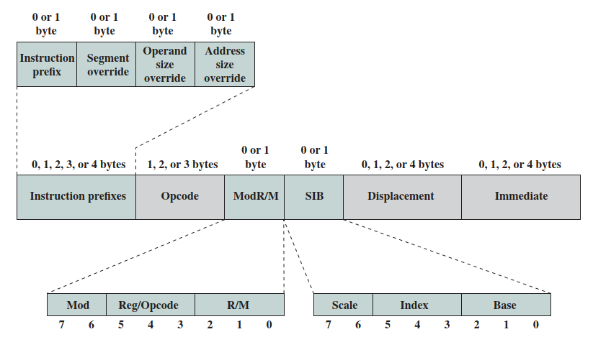
X86 Instruction Formats
Instructions includes:
Instruction prefixes (optional)
Opcode (always present)
Address specifier (optional, ModR/M and SIB)
Displacement (optional)
Immediate field (optional)
2Eh
36h
3Eh
26h
64h
65h
F0h
F3h
F2h
66h
67h
^{<number>}
Notes:
http://www.c-jump.com/CIS77/CPU/x86/lecture.html

Slide 19
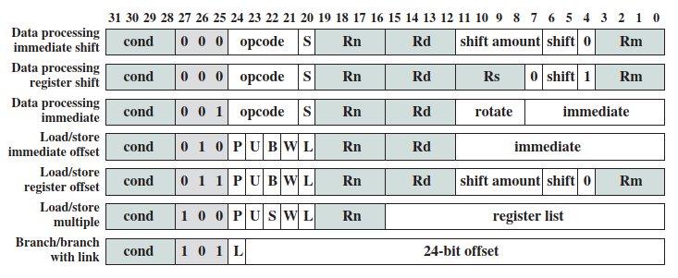
ARM Instruction Formats
ARM instructions are 32 bits long and follow a regular format
The first four bits of an instruction are the condition code
The next three bits specify the general type of instruction
Next five bits constitute an opcode and/or modifier bits for the operation.
The remaining 20 bits are for operand addressing
^{<number>}

Slide 20
Outline
Basics of instruction set
Addressing mode in instruction set
Instruction formats
OS support
^{<number>}

Slide 21
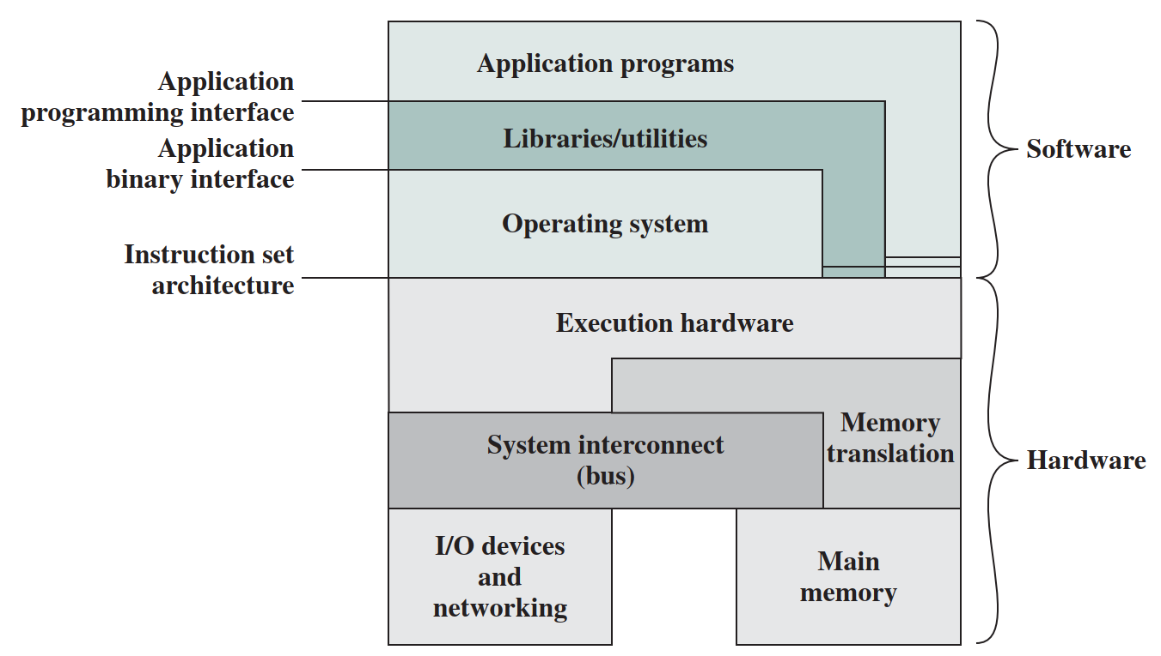
5.1 Introduction
OS Support
Instruction set is the boundary between software and hardware.
Different processor series may have different instruction set, e.g. Intel, AMD, ARM, RISC.
To develop an application program directly using processor instruction set can be very complex → OS.
^{<number>}
Hardware and software of a computer

Slide 22
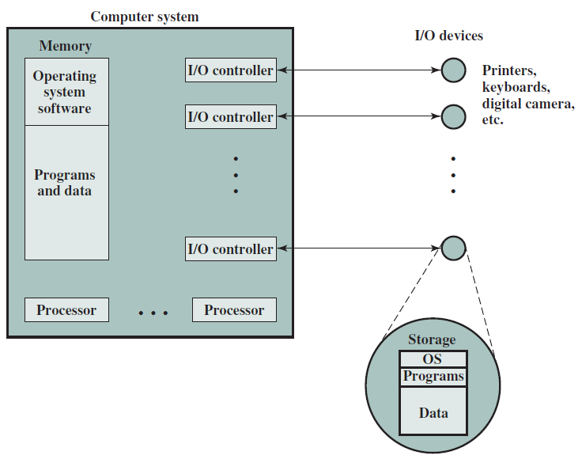
5.1 Introduction
OS Support
The OS masks the details of the hardware from the programmer and provides the programmer with a convenient interface for using the system.
The OS can be regarded as the resource manager of a computer with processor, memory, I/O, and interconnections.
^{<number>}

Slide 23
Thank you!
Q&A
^{<number>}

